Slide 1

Automated Auditing of Financial Statements
(Group 6)
DeepAudit
Thomas Bienasz
Xinrui Chen
Keerthana Kannan
Kurtis Lazenby
Ella Salafranca
Nathan Soares
Notes:
Good evening everyone, We’re group 6 and we’re working with BT Financial group.

Slide 2






Group 6 Members
Sherry
Keerthana
Ella
Kurtis
Nathan
Thomas
Notes:
I’m Ella and I’ll be introducing our project objective and the model flowchart. Keerthana, will go onto the depths of the model we chose, followed by Thomas and Nathan who will discuss the data insights. Following this, Sherry will discuss the Model evaluation and Nathan and Thomas will conclude the presentation.

Slide 3
Project Purpose and Objectives
The Problem:
Companies misrepresent their operations (intentionally or unintentionally) in their financial statements
This is difficult to identify manually and generally relies on tip-offs
The Objective:
Develop a data model that can automatically identify periods where suspicious or fraudulent reporting occurred
Speaker: Ella
Purpose & Objectives
Model Flowchart
Beneish Model
Data Insights
Model Evaluation
Next Steps
Notes:
The main problem presented to us is that auditing financial statements is a tedious, expensive and error-prone process, particularly because it is done manually. Auditing these statements is necessary because a portion of firms commit fraud or engage in suspicious activities either knowingly or unknowingly. Our project aims to automate this process using a data model which can be applied to a broad range of firms, providing a higher degree of predictability and accuracy rather than manual auditing.

Slide 4
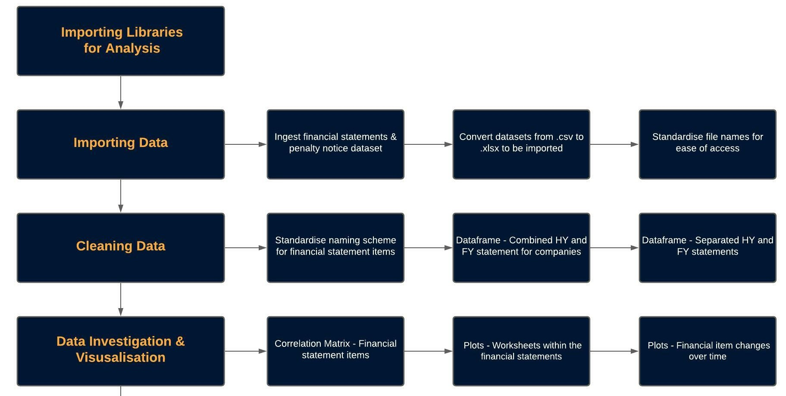
Model Flowchart
Speaker: Ella
Purpose & Objectives
Model Flowchart
Beneish Model
Data Insights
Model Evaluation
Next Steps

Slide 5
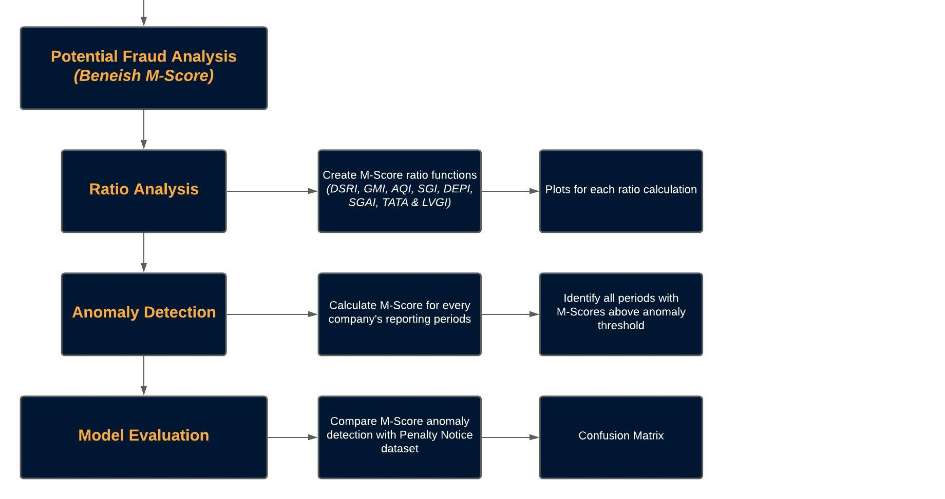
Model Flowchart
Speaker: Ella
Purpose & Objectives
Model Flowchart
Beneish Model
Data Insights
Model Evaluation
Next Steps

Slide 6
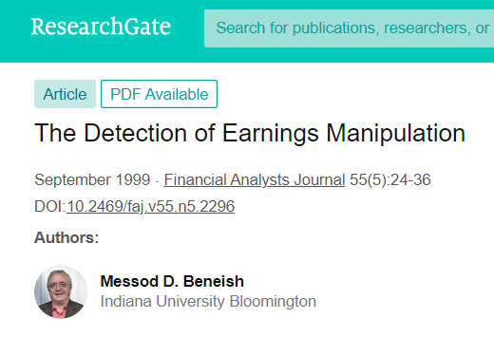
Beneish Model
Used to identify manipulation in financial statements
“The Detection of Earnings Manipulation” (Prof. M.Beneish,1999)
Model generates a ‘Manipulation score’ (M-Score)
Detects the likelihood of manipulation
Aimed to identify specific periods a company manipulated data
Based on 8 Financial Ratios
Speaker: Keerthana
Purpose & Objectives
Model Flowchart
Beneish Model
Data Insights
Model Evaluation
Next Steps
Notes:
The Beneish M-Score model is a method of fraud detection that is supported by numerous peer reviewed articles. The model was created by Professor Beneish in his paper “The Detection of Earnings Manipulation” in 1999. The Manipulation-Score uses 8 financial ratios extracted from the company’s financial statements to identify items that are manipulated. Now let’s look at the breakdown of the ratios used.

Slide 7
Beneish Model: Financial Ratios
DSRI
GMI
AQI
SGI
Gross Margin Index
Asset Quality Index
Sales Growth Index
Days Sales in Receivable Index
Excessive capitalisation costs
Drastic change between periods- manipulation in earnings
Dramatic change (increase) - Revenue Manipulation
Deterioration in earnings, inflation in profits
Speaker: Keerthana
Purpose & Objectives
Model Flowchart
Beneish Model
Data Insights
Model Evaluation
Next Steps
Notes:
A dramatic increase in the DSRI between different periods indicates revenue manipulation. The purpose of the GMI is to flag any deterioration in earnings to further investigate the company’s motive to inflate profits. An increase in AQI suggests excessive capitalisation of costs. Changes between periods for the SGI in growing companies indicates some manipulation trying to meet earnings targets.

Slide 8
Beneish Model: Financial Ratios
DEPI
SGAI
TATA
LVGI
Sales,General & Administrative Expense Index
Total Accruals to Total Assets
Leverage Index
Depreciation Index
Higher positive accruals means higher likelihood of manipulation
Higher Leverage ratio, higher the possibility of manipulation
Depreciation rate has been lowered due to increase in income
Major change (decreased) between periods - earnings manipulated
Speaker: Keerthana
Purpose & Objectives
Model Flowchart
Beneish Model
Data Insights
Model Evaluation
Next Steps
Notes:
A DEPI ratio greater than 1 means that the depreciation rate has lowered indicating an increase in income due to policy changes or new methods being adopted. If a company is predisposed to manipulating earnings, the SGAI decreases. The TATA looks at non-cash earnings and indicates a higher positive accrual which means higher likelihood of manipulation. And finally, higher leverage ratio means higher possibility of manipulation as well.

Slide 9
Beneish Model: M-Score
M-Score > -1.78 (Earnings manipulation)
M-Score < -1.78 (No manipulation)
Speaker: Keerthana
Purpose & Objectives
Model Flowchart
Beneish Model
Data Insights
Model Evaluation
Next Steps
Notes:
The overall M-Score is calculated using this formula, with the weighted ratios put together by Beneish. M-Score greater than -1.78, indicates earnings manipulation. Tom and Nathan will discuss the Data Insights for our project. (Thank you)

Slide 10
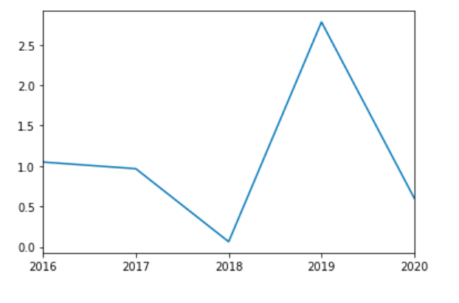
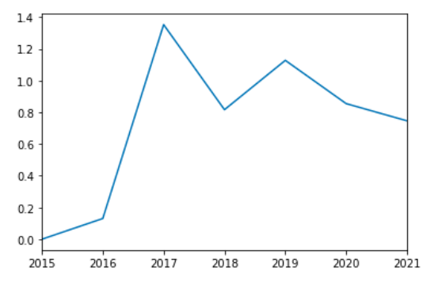
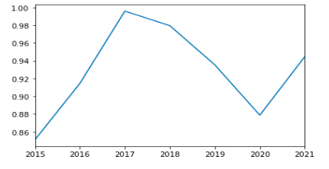
Data Insights: Visualisation
DSRI(Days Sales in Receivable)
GMI(Gross Margin Index)
AQI(Asset Quality Index)
Speaker: Thomas
Purpose & Objectives
Model Flowchart
Beneish Model
Data Insights
Model Evaluation
Next Steps
Notes:
Thanks keerthana, Now we move onto the visualisation of our models. Here we can see our first three models being implemented and producing a graph which lets us display the results of the calculations for our users.

Slide 11
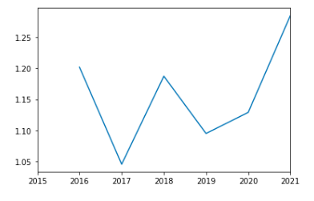
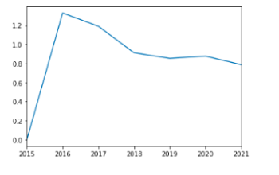
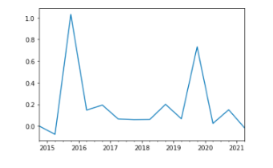
Data Insights: Visualisation
Continued
SGI(Sales Growth Index)
DEPI(Depreciation Index)
TATA(Total Accruals to Total Assets)
Speaker: Thomas
Purpose & Objectives
Model Flowchart
Beneish Model
Data Insights
Model Evaluation
Next Steps
Notes:
Similarly here, after the necessary calculations are done, we see the display of the Sales growth index, total accruals to total assets and the depreciation index.

Slide 12
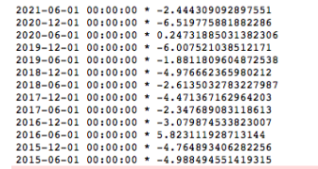
Data Insights: Visualisation
Continued
LVGI (Leverage Index)
Preliminary M-Score Output
Speaker: Thomas
Purpose & Objectives
Model Flowchart
Beneish Model
Data Insights
Model Evaluation
Next Steps
Notes:
Finally, our last two calculations that get presented here are the leverage index as well as a preliminary output of the very important m-score. When these scores exceed a value of -1.78, the period is determined to contain some sort of fraudulent activity, which explored further in the next table.

Slide 13
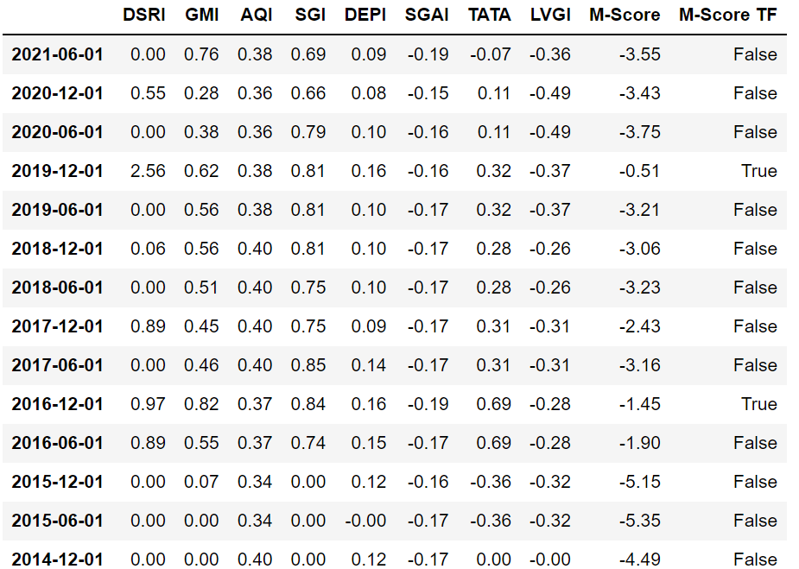
Data Insights (Adairs Ltd. Example)
Speaker: Thomas
Purpose & Objectives
Model Flowchart
Beneish Model
Data Insights
Model Evaluation
Next Steps
Notes:
This table here summarises the core of what our project aimed to produce, using the example of Adairs Limited, which is a furniture merchandising company. The columns highlighted in blue show us the financial ratios calculated for each period, weighted by their contribution to the M-Score calculation.

Slide 14
Data Insights (Adairs Ltd. Example)
Speaker: Thomas
Purpose & Objectives
Model Flowchart
Beneish Model
Data Insights
Model Evaluation
Next Steps
Notes:
But for now, let’s focus on the final M-Score columns highlighted in green. Based on the Beneish model, any M-Scores exceeding -1.78 indicate an anomalous reporting period. In this case we can see that Adairs’ 2016 and 2019 inter-im reporting periods were predicted to be anomalous, with m-scores of -1.45 and -0.51 respectively. As a reminder, the higher M-Scores indicate a higher degree of abnormality. Now i'll pass it onto Nathan.

Slide 15
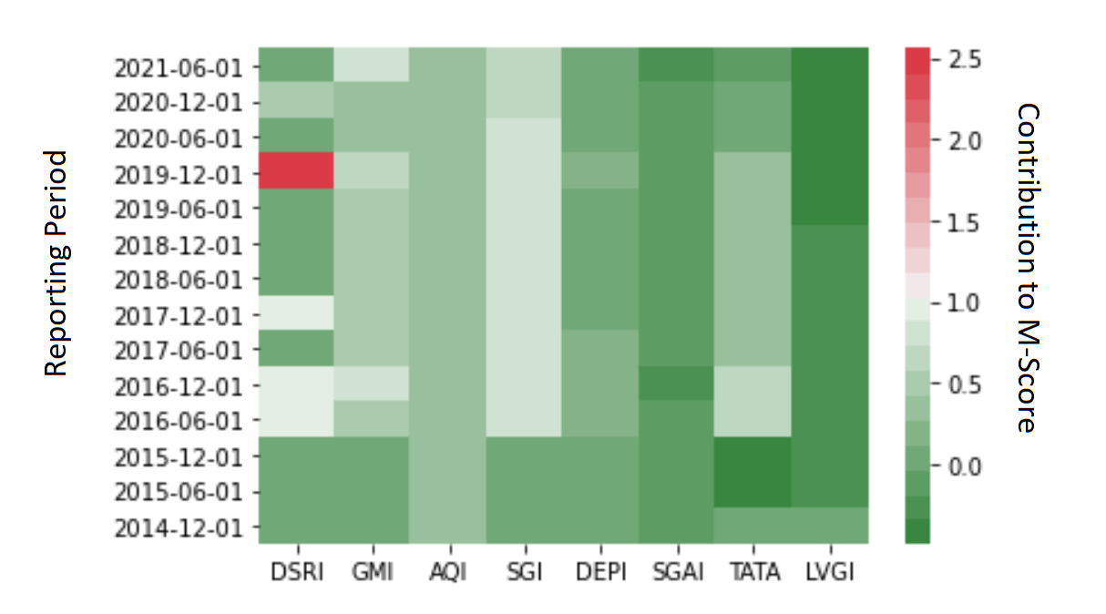
Data Insights
Speaker: Nathan
Purpose & Objectives
Model Flowchart
Beneish Model
Data Insights
Model Evaluation
Next Steps
Notes:
Let’s now have a closer look at why these periods were considered anomalous and how they compare to other periods. This heatmap visually presents to us the contribution of the ratios from the previous table. For a normal period with no manipulation, we would expect the entire row of ratios to be green. As the colours progress towards red however, this indicates a ratio that is particularly anomalous. For example, we can see that the Days Sales receivables index for the 2019 had a considerable large impact on the M-Score, and to a lesser extent so did the sales growth index. Let’s take a closer look at these periods.

Slide 16
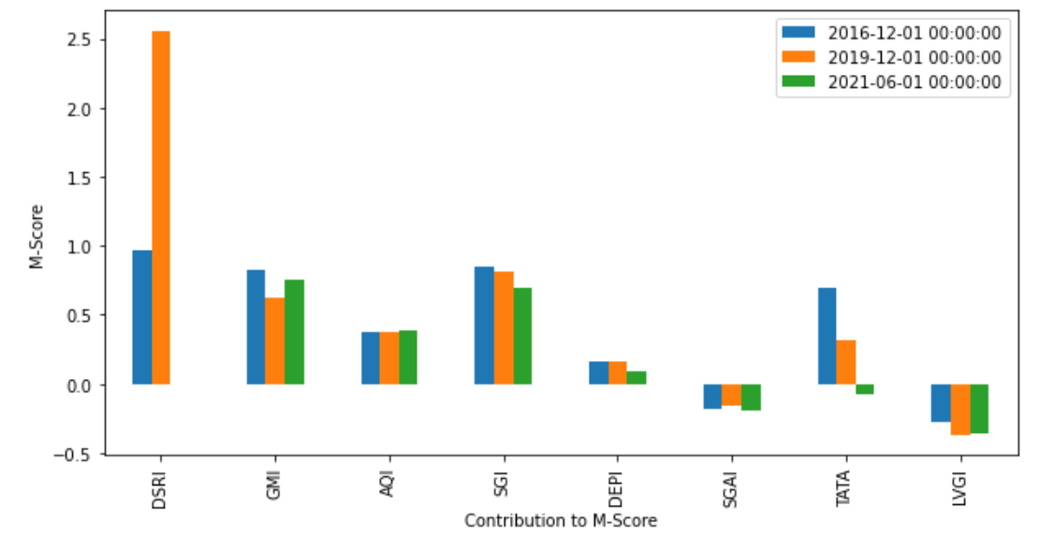
Data Insights
Speaker: Nathan
Purpose & Objectives
Model Flowchart
Beneish Model
Data Insights
Model Evaluation
Next Steps
Notes:
In blue and orange we have the two predicted anomalous periods for Adairs, and for comparison we’ve included the most recent period in green which is normal. Higher values are worse here and indicate a higher degree of abnormality, and we can easily see that DSRI is a particularly concerning factor

Slide 17
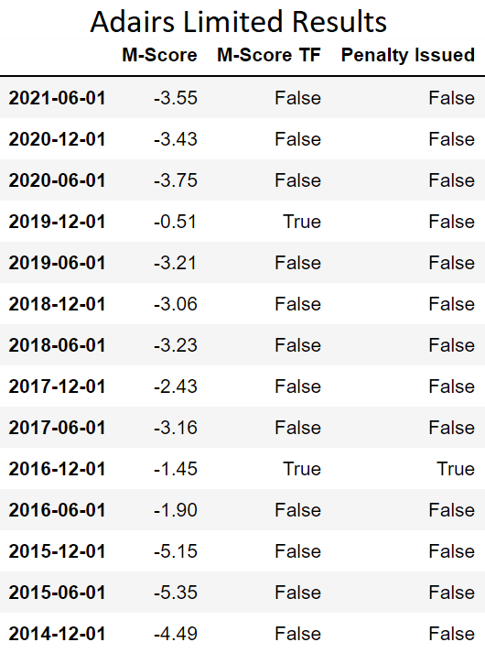
Model Evaluation - Confusion Matrix
553 Total Periods |  | Predicted
 |  | Normal | Anomaly
Actual | Normal | 347 | 178
 | Anomaly | 13 | 15
Speaker: Sherry
Purpose & Objectives
Model Flowchart
Beneish Model
Data Insights
Model Evaluation
Next Steps

Slide 18
Model Evaluation - Confusion Matrix
553 Total Periods |  | Predicted
 |  | Normal | Anomaly
Actual | Normal | 347 | 178
 | Anomaly | 13 | 15
Speaker: Sherry
Purpose & Objectives
Model Flowchart
Beneish Model
Data Insights
Model Evaluation
Next Steps

Slide 19
Model Evaluation - Confusion Matrix
553 Total Periods |  | Predicted
 |  | Normal | Anomaly
Actual | Normal | 347 | 178
 | Anomaly | 13 | 15
Speaker: Sherry
Purpose & Objectives
Model Flowchart
Beneish Model
Data Insights
Model Evaluation
Next Steps

Slide 20
Model Evaluation - Confusion Matrix (New Regression of M-Score weights)
553 Total Periods |  | Predicted
 |  | Normal | Anomaly
Actual | Normal | 316 | 209
 | Anomaly | 16 | 12
Speaker: Sherry
Purpose & Objectives
Model Flowchart
Beneish Model
Data Insights
Model Evaluation
Next Steps
Notes:
Didn’t perform quite as well when we regressed our own weights of the m-score factors

Slide 21
Next Steps
Further investigating neural network approach
Implement feedback loop from investigated periods
Clustering for new regression / neural net factors
Speaker: Nathan
Purpose & Objectives
Model Flowchart
Beneish Model
Data Insights
Model Evaluation
Next Steps

Slide 22
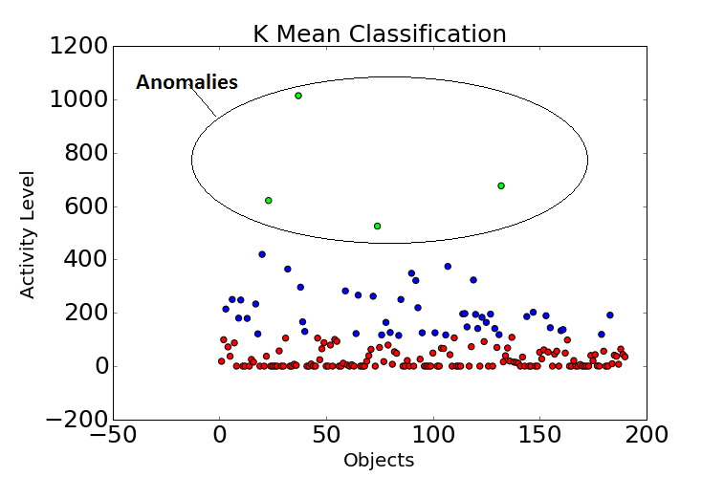
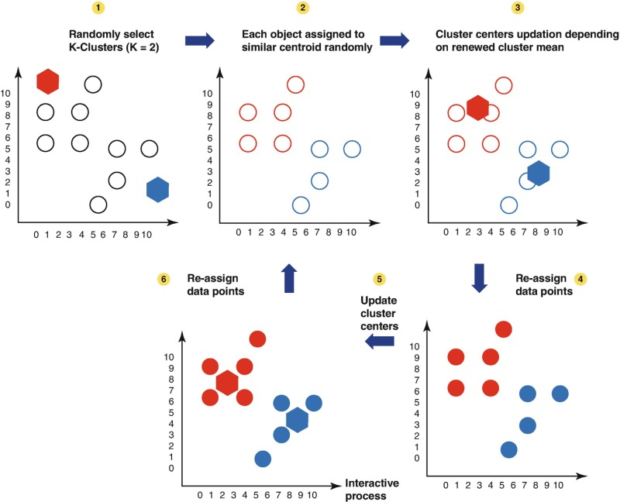
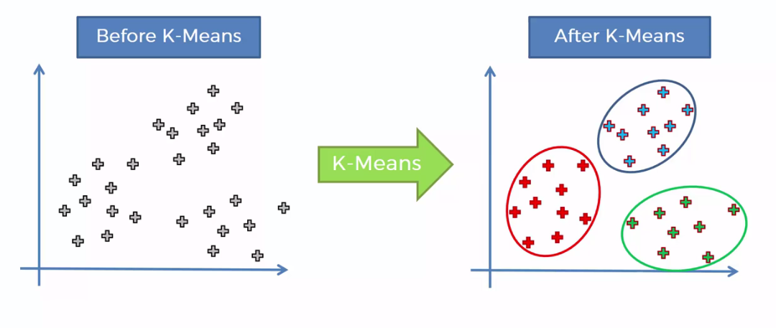
Next Steps: K-Means Clustering
How it works: takes data points as the input and groups them into k clusters
For the future, K-means could be used to detect and remove outliers
K-means would present interesting patterns or trends
Speaker: Thomas
Purpose & Objectives
Model Flowchart
Beneish Model
Data Insights
Model Evaluation
Next Steps
Notes:
So, lets look into K-means a bit further. K-means is an unsupervised learning algorithm that groups an unlabeled dataset into different clusters. A future enhancement that we could use is for detecting outliers and removing them from the dataset in order to improve the grouping precision. Also it would provide us with different patterns and cluster analysis as it is easy to implement and is versatile.

Slide 23
Thank you for listening
GROUP 6
Notes:
On behalf of group 6 we would like to thank our sponsor Fouad and (supervisor/LES) for attending our presentation today. We hope you enjoyed it and we are now open to answer any questions or queries that you may have. Thank you for listening !

